Slide 1
ME 417 Final Project
Self-Parking Car
Nezih Sunman & Ayhan Alp Aydeniz

Slide 2
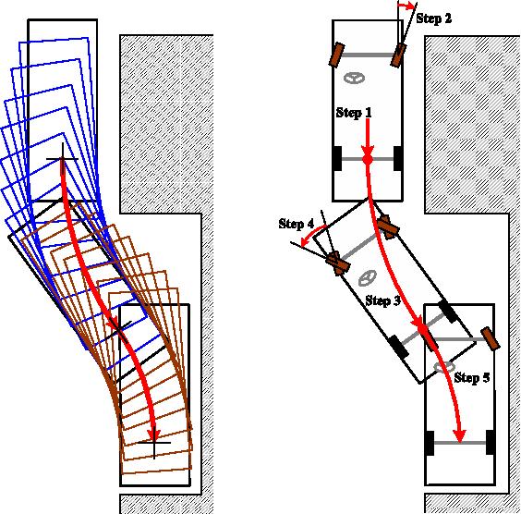
Introduction
Self Parking Car is based on finite state machine (FSM)
A Certain Geometry And Method

Slide 3
Objective
Self Parking Car in just parking available parking area
Certain Geometry Movement
Taking sensor input via the movement of the car

Slide 4
First step : Design and Schema 15.02.2019
Second step: Purchasing 28.02.2019 & 07.03.2019
Third point: Assembly end of the March
Fourth point: Coding the State Machine Logic
Fifth point: Testing
Sixth point: Presentation and Report (ongoing)

Slide 5
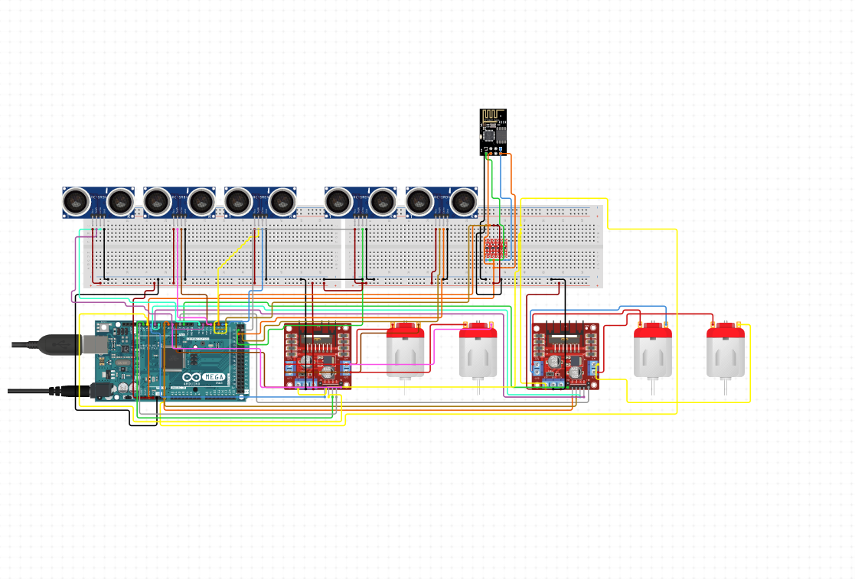
Design and Schematic
4 piece 6V 250 RPM Motor and Wheel Set
2 L298N Motor Driver
1 NodeMCU 1.0 For Wireless
5 HC-SR04 Arduino Ultrasonic Distance Sensor
1 Arduino Mega
1 Li-Po Battery 11.1 V 3S 2000mah
And lots of JUMPERS

Slide 6
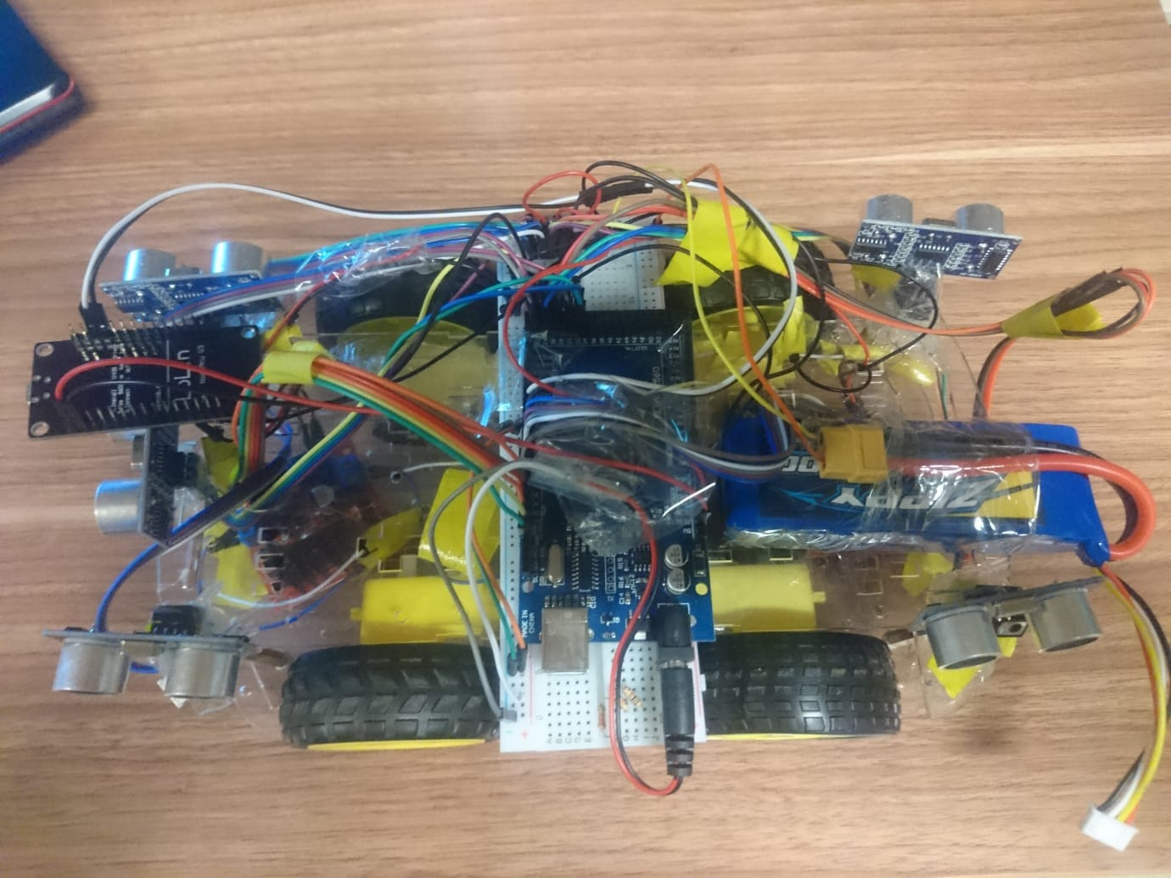
Assembly

Slide 7
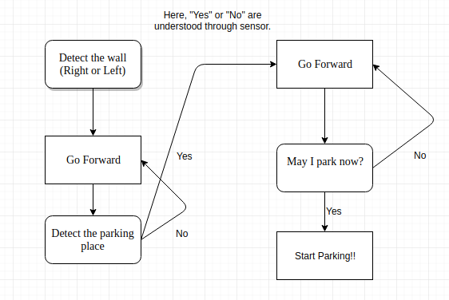
Implementation of Finite State Machine Logic

Slide 8
4 Different Parking Styles:
Left and right Back Park
Front and left front parking
Change left and right lane to the nearest one
Manual parking from Android App

Slide 9
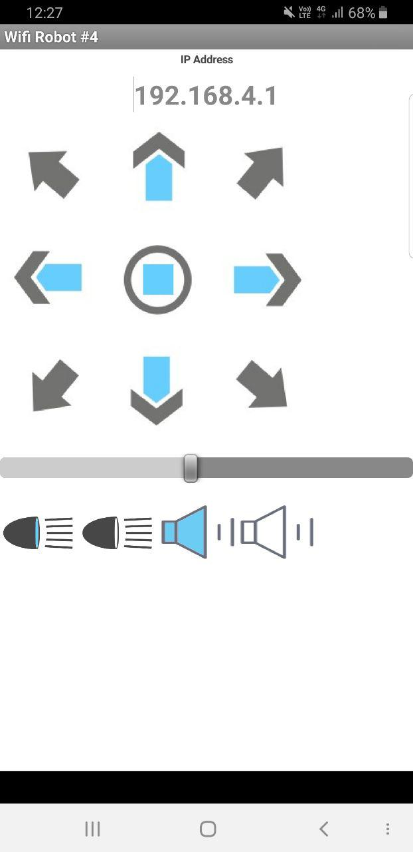
Android App
Source (https://create.arduino.cc/projecthub/andriy-baranov/from-bt-to-wifi-creating-wifi-controlled-arduino-robot-car-09b7c1)

Slide 10
Result:
Rx-Tx Comminication I2C protocol
Wifi Connection and Android Application
Parking Strategies in Multiple Case
Taking Multiple Sensor Input and Output Simultaneously

Slide 11
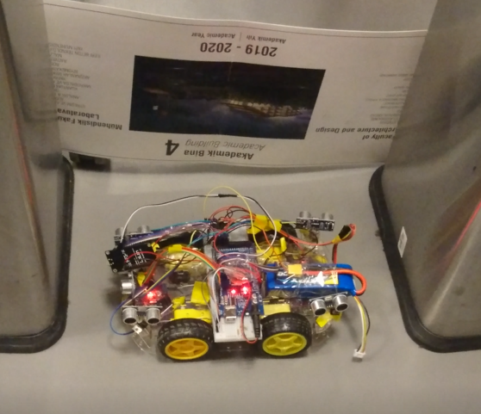
Lastly ...
Self Parking Car & Videos

Slide 12
Is there any questions?
Thank you

